Slide 1
Lesson 10 Operating System Customization
Computer Literacy BASICS: A Comprehensive Guide to IC³, 4th Edition
Morrison / Wells

Slide 2
Objectives
Use the Control Panel.
Select Control Panel settings.
Set up printers.
Change system settings.
Install and uninstall software.
Troubleshoot common software problems.
2
2

Slide 3
Vocabulary
Appearance and Personalization category
Clock, Language, and Region category
Control Panel
Ease of Access category
Hardware and Sound category
Mail Setup
Network and Internet category
notification area
Program Compatibility Wizard
3
3

Slide 4
Vocabulary (continued)
Programs category
startup program
System and Security category
System Restore
system setting
User Accounts and Family Safety category
4
4

Slide 5
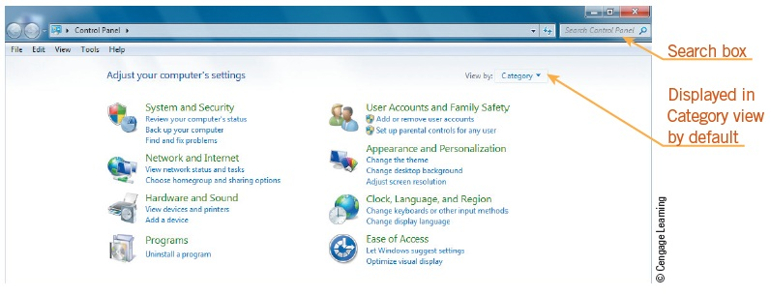
Using the Control Panel
You use the Control Panel to change and customize settings on your computer, such as the desktop, time zone, and account picture.
5
5

Slide 6
Using the Control Panel (continued)
The System and Security category includes settings for a variety of system tasks.
The Network and Internet category help you to connect to the Internet, view a network and its computers and devices, synchronize with other computers, and perform other networking tasks.
The Hardware and Sound category, which lets you manage hardware devices such as printers, the mouse, and the keyboard.
6
6

Slide 7
Using the Control Panel (continued)
The Programs category allow you to uninstall a program or view installed updates.
Using the User Accounts and Family Safety category, you can change user accounts and passwords, set up parental controls, change a user’s online profile, manage Windows credentials, and manage e-mail accounts.
The Appearance and Personalization category provides options to personalize the desktop by selecting a new color scheme, changing the background, adjusting the screen resolution, and so on.
7
7

Slide 8
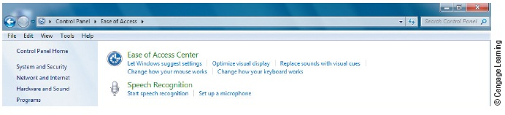
Using the Control Panel (continued)
The Clock, Language, and Region category contains options that help you localize your computer.
The Ease of Access category helps to make your computer accessible to all users.
8
8

Slide 9
Selecting Control Panel Settings
Common Control Panel System Settings:
Change typical settings such as date and time, display settings, audio volume, mouse and keyboard, disability settings, and security.
Date and Time Settings:
The Date and Time category provides the following options: Set the time and date, Change the time zone, Add clocks for different time zones, and Add the Clock gadget to the desktop.
9
9

Slide 10
Selecting Control Panel Settings (continued)
Date and Time Settings (continued):
You also can change some settings by clicking the appropriate icon on the right side of the taskbar, which is called the notification area.
Mouse and Sound Settings:
Mouse and keyboard settings also can be changed to meet your particular needs and requirements.
10
10

Slide 11
Selecting Control Panel Settings (continued)
Security Settings:
Network firewall
Windows Update
Virus protection
Spyware and unwanted software protection
Internet security settings
User Account Control
Network Access Protection
11
11

Slide 12
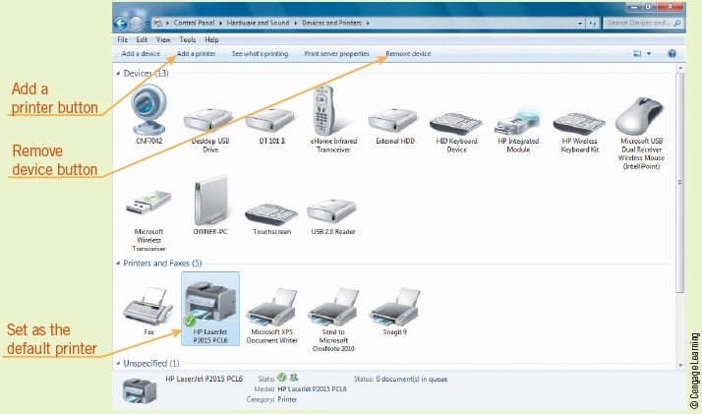
Setting Up Printers
Using the Devices and Printers option in the Hardware and Sound window makes it easy to add or remove printers.
12
12

Slide 13
Changing System Settings
With the proper permissions, you can use the Control Panel to change your computer’s system settings, which are the settings that affect the entire computer.
System Restore creates and saves restore points on a regular basis.
13
13

Slide 14
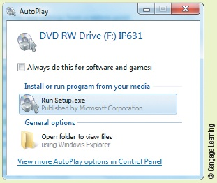
Installing and Uninstalling Software
Installing new or updated software is a simple procedure that starts by inserting a CD or DVD or by downloading a program from the Internet.
14
14

Slide 15
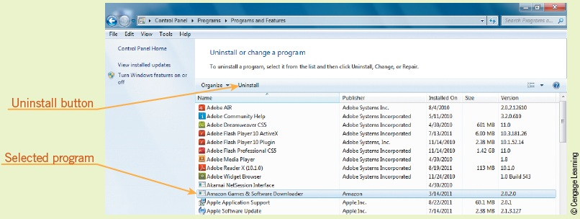
Installing and Uninstalling Software (continued)
Uninstalling Software Programs:
When software programs become outdated or are no longer used, you should uninstall them from the computer’s hard drive.
15
15

Slide 16
Installing and Uninstalling Software (continued)
Software as a Service (SaaS):
To subscribe to a SaaS application, you must pay a monthly or annual subscription fee, and then access the software online.
Managing User Accounts:
Windows 7 has two types of user accounts: standard user accounts and administrator accounts.
16
16

Slide 17
Installing and Uninstalling Software (continued)
Managing User Accounts (continued):
User Account options in the Control Panel:
Change your picture
Change your account name
Change your account type
Manage another account
Using Mail Setup, you can create e-mail accounts and directories, change settings for Outlook files, and set up multiple profiles of e-mail accounts and data files.
17
17

Slide 18
Troubleshooting Common Software Problems
Common installation problems include:
Install/uninstall software on a network
Defective or lost installation media
Installation program will not start
Installation stops before completion
Installed program is not displayed
Installed program fails to work
Other programs fail to work after new product is installed
Files cannot be read by new application
Access to an online application is denied
Online application not available
18
18

Slide 19
Summary
In this lesson, you learned:
You use the Control Panel to change and customize settings on your computer. One popular category is System and Security, which provides settings for a variety of system tasks, such as backup and restore, power options, and Windows Update. Another frequently used category is Appearance and Personalization, which provides options to personalize the desktop by selecting a new color scheme, changing the background, and adjusting the screen resolution.
19
19

Slide 20
Summary (continued)
You also can change some system and program settings by double-clicking the appropriate icon in the notification area of the taskbar.
The Action Center provides options to turn a network firewall on or off, set up Windows Update for automatic updating, select programs for virus and spyware protection, set Internet security options, and other security settings.
20
20

Slide 21
Summary (continued)
When you use the Control Panel to change your computer’s system settings, make sure you understand the effect the change will have on the computer. It also is a good idea to record the original settings. If you do make a system change that makes your system unstable, you can use Windows System Restore, a built-in tool that creates and saves restore points on a regular basis.
21
21

Slide 22
Summary (continued)
You can install software from installation media such as a CD or DVD, or from a file downloaded from a Web site. In either case, you follow similar steps: double-click the setup or install file, and then follow the prompts to install the software.
To uninstall software, open the Control Panel, and then use the Uninstall link in the Programs category to remove the software from your computer.
22
22

Slide 23
Summary (continued)
Windows 7 has two types of user accounts: Standard user accounts and Administrator accounts. Standard users cannot install or uninstall applications in the root directory, change system settings, or perform other administrative tasks unless they can provide the correct password for the Administrator account.
23
23

Slide 24
Summary (continued)
Typical software problems include defective or lost installation media, an installation program that does not start or starts and then stops, an installed program that does not open, and other programs failing to work after a new product is installed.
24
24

